Slide 1
SS ZG 526: Distributed Computing
Causal Ordering of Messages
Chittaranjan Hota
Professor, Dept. of Computer Sc. & Information Systems
BITS, Pilani Hyderabad Campus, Hyderabad
hota@hyderabad.bits-pilani.ac.in

Slide 2

Schiper-Eggli-Sandoz (SES) protocol
No need for broadcast messages.
Each process maintains a vector V_P of size N - 1, N being the number of processes in the system.
V_P is a vector of tuple (P’,t): P’ the destination process id and t, a vector timestamp.
T_{m}: logical time of sending message ‘m’
T_{pi}: present logical time at p_{i}
Initially, V_P is empty.

Slide 3

SES Continued…
Sending a Message:
  Send message M, time stamped t_{m}, along with V_P1 to P2.
  Insert (P2, t_{m}) into V_P1. Overwrite the previous value of (P2,t), if any.
  (P2,t_{m}) is not sent. Any future message carrying (P2,t_{m}) in V_P1 cannot be delivered to P2 until t_{m} < T_{p2}.
Delivering a message
  If V_M (in the message) does not contain any pair (P2, t), it can be delivered.
  /* (P2, t) exists in V_M*/ If t !< Tp2, buffer the message. (Don’t deliver).
  else (t < Tp2) deliver it

Slide 4
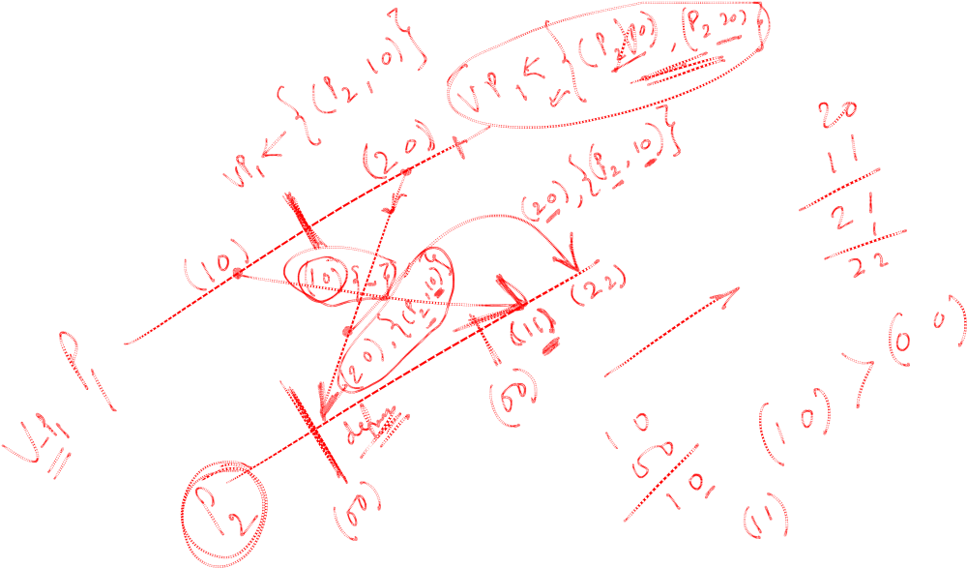
Example1 of SES

Slide 5
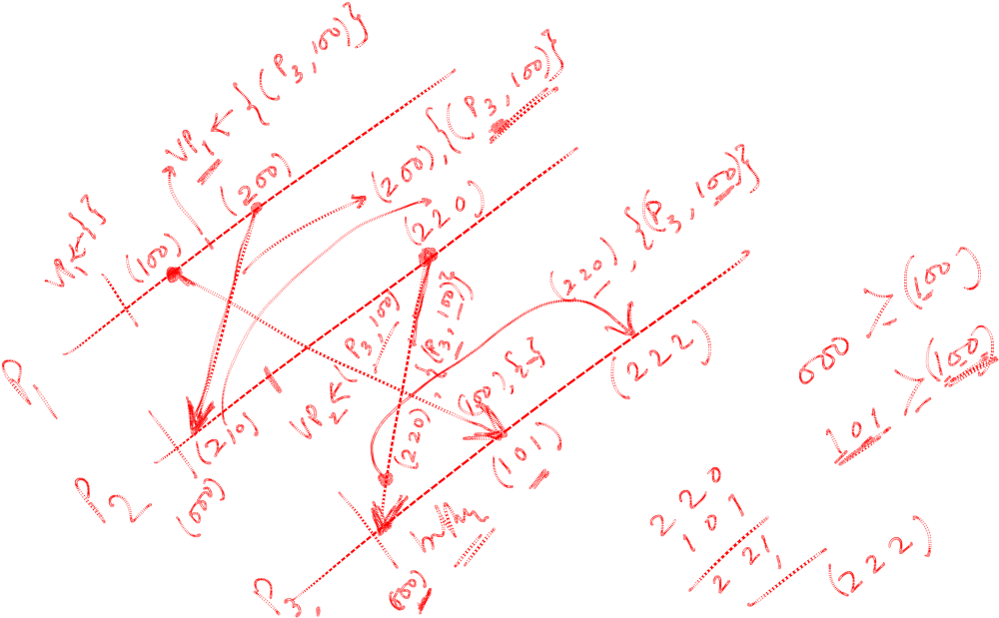
Example2 of SES

Slide 6
Next module
Distributed mutual exclusion
Birla Institute of Technology and Science, Pilani (Deemed University)

